Slide 1
ANET A8 PLUS 3D Printer Development with BIGTREETECH SKR 2 BOARD, TMC2209, Volcano V6 Extruder, MARLIN 2.0.9.2.0, Raspberry PI 3b+ and Octoprint
Created: Gábor Dernóczi

Slide 2
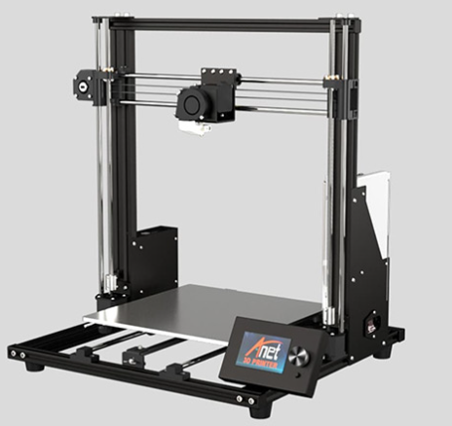
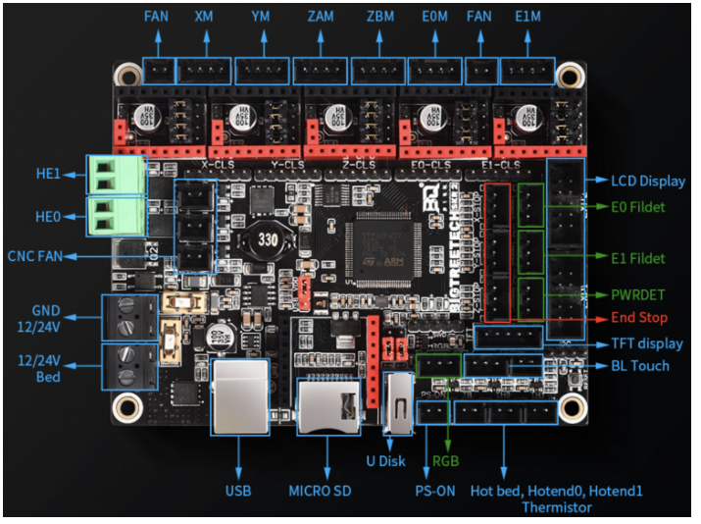
Anet A8 Plus upgrade with SKR2 REV B board

Slide 3
Exp2
Exp1

Slide 4
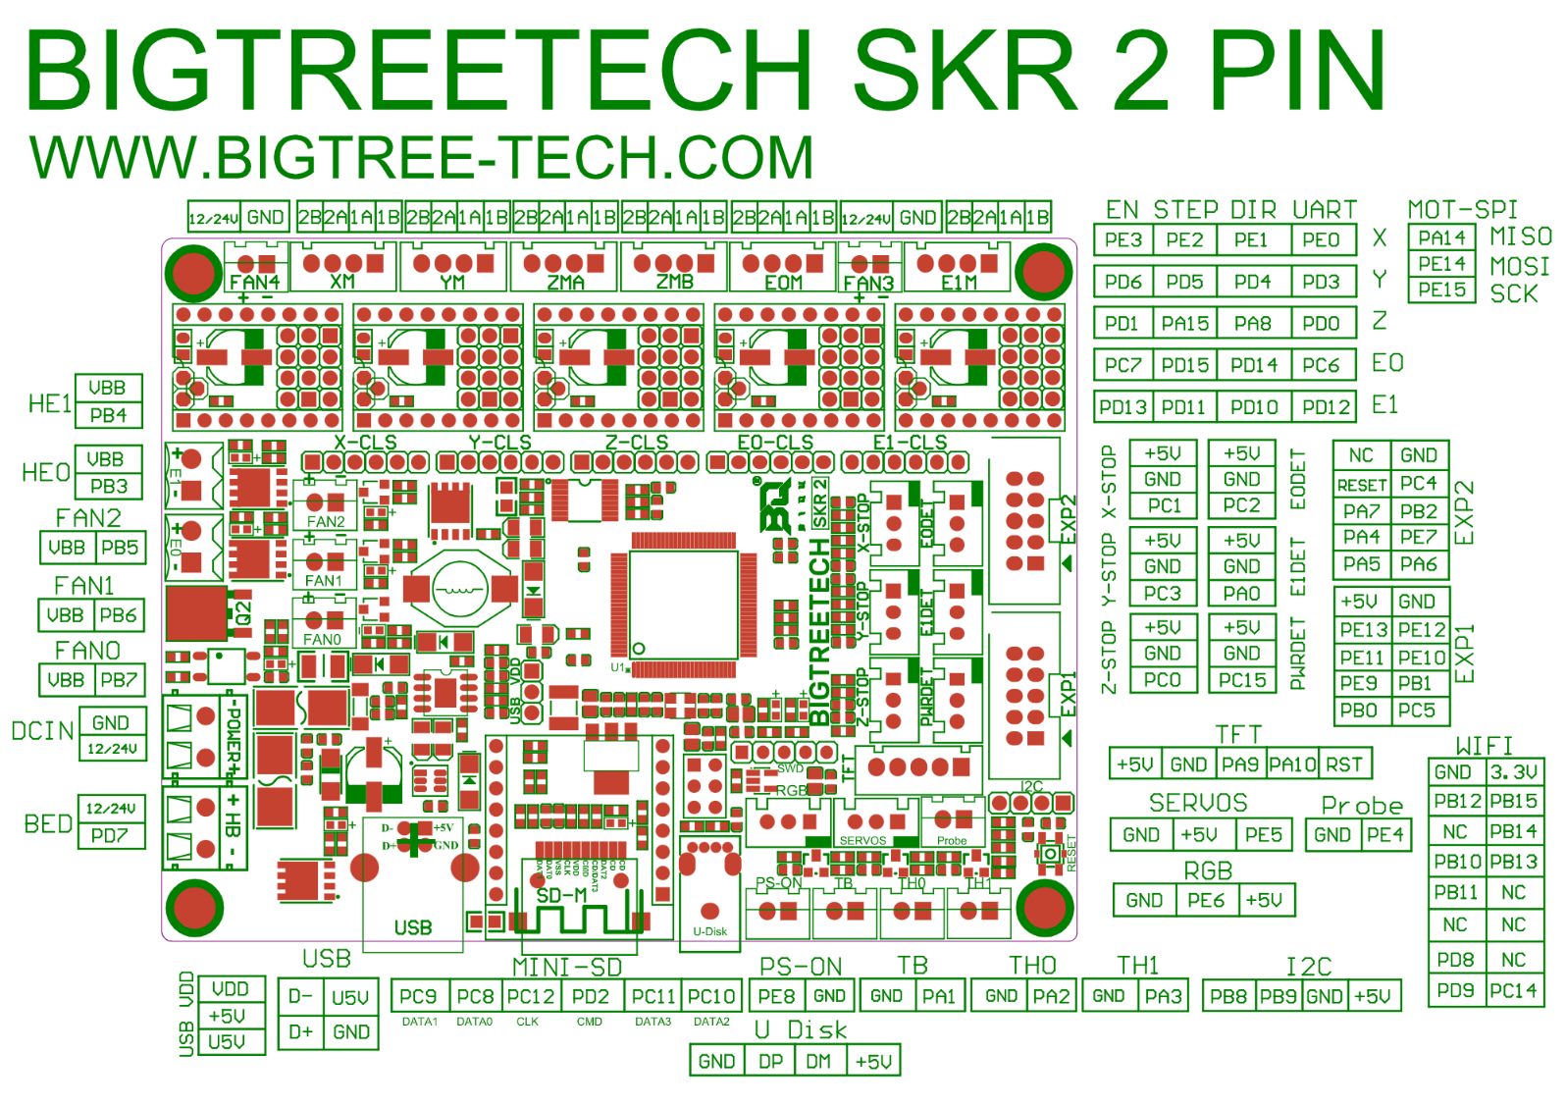

Slide 5
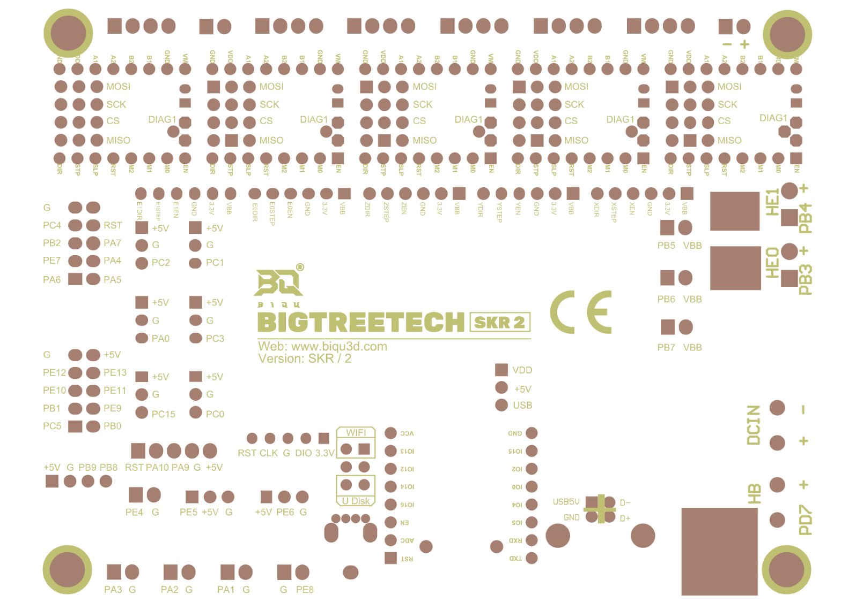

Slide 6
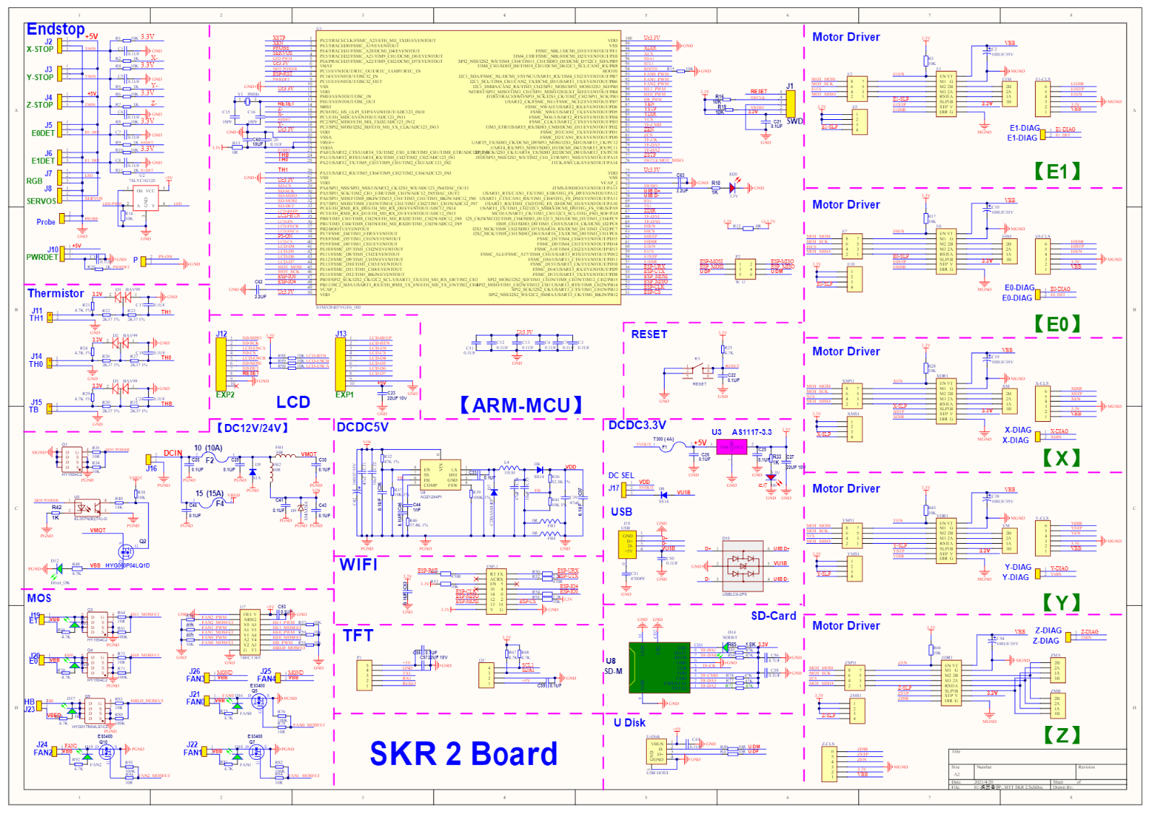

Slide 7
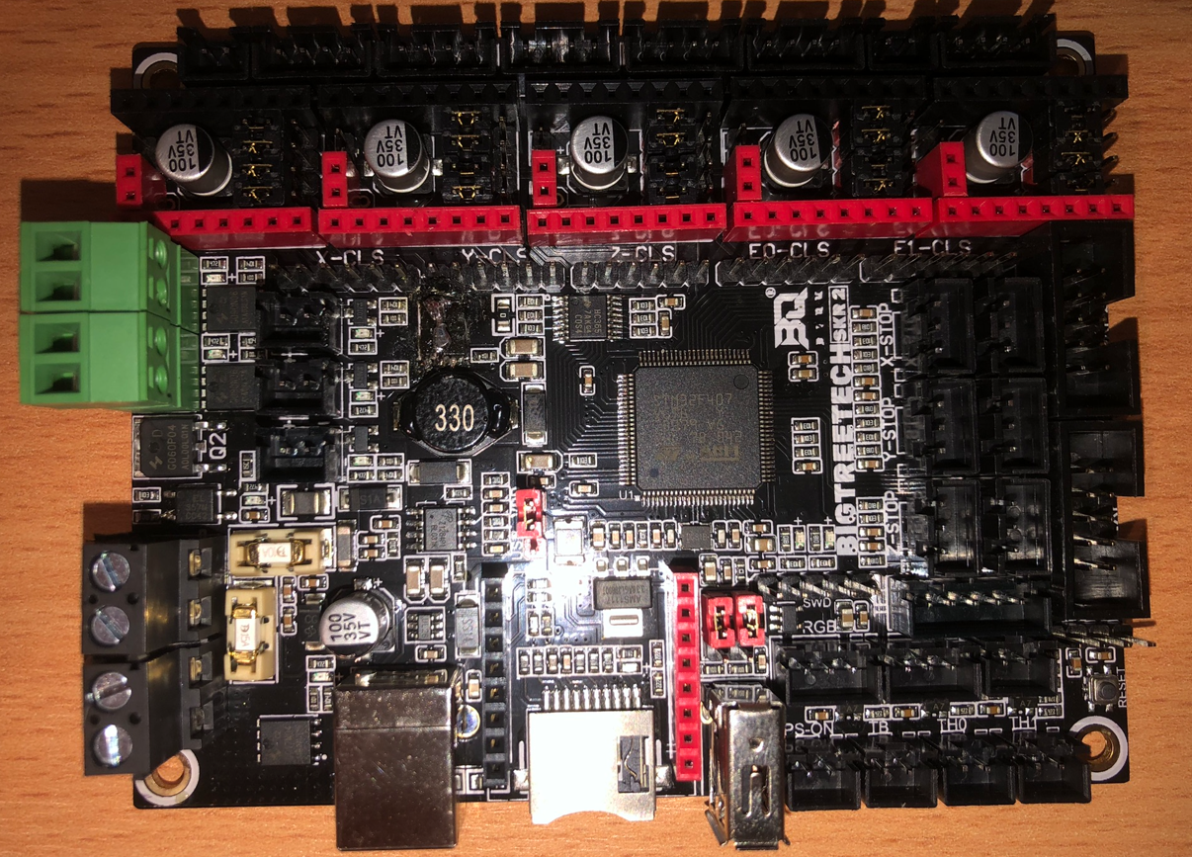
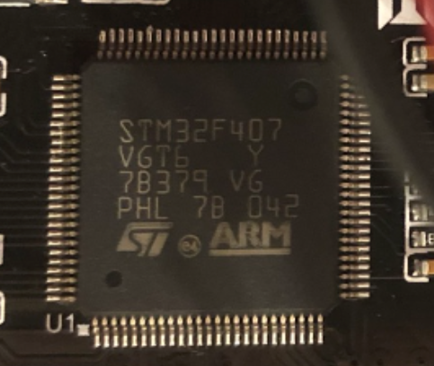
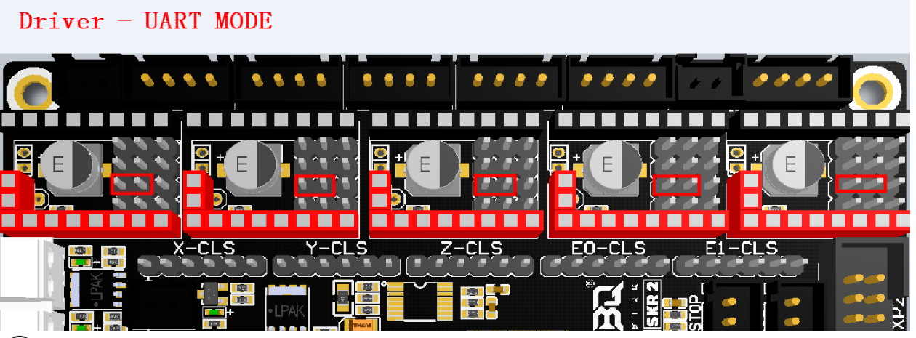
Soldering of wrong FET S-D to GND
Jumpers need to be set to UART mode on left side for TMC2209
GND soldering over the FET OK
One leg was not soldered

Slide 8
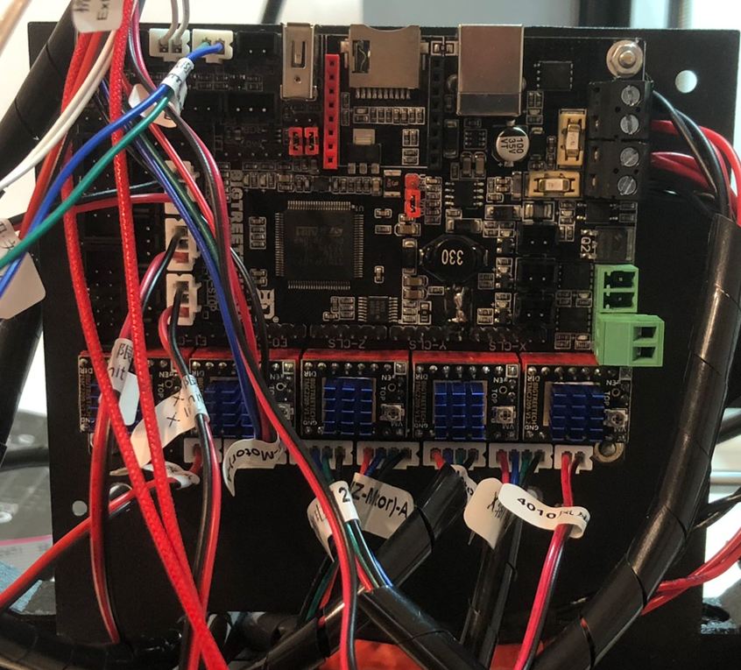
Measure common GND bw. these points
Heated Bed
24V DC
Extruder heater
5pcs TMC2209 v1.2

Slide 9
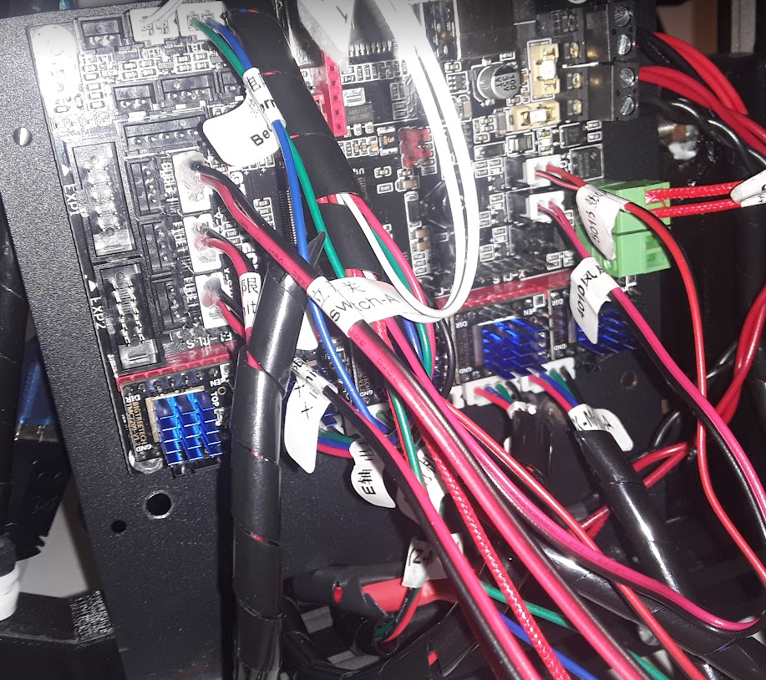
Limit switches are switching GND to PCx inputs
Limit switches
Extruder Fan 1=PB7 and COOLER Fan =PB6
Red, Blue, Green, Black
Stepper motors

Slide 10
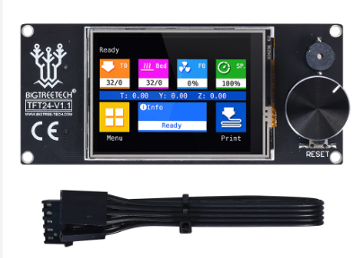
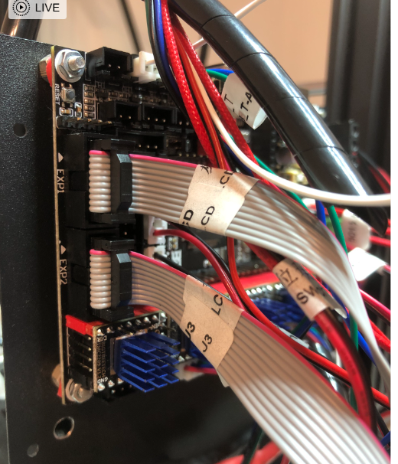
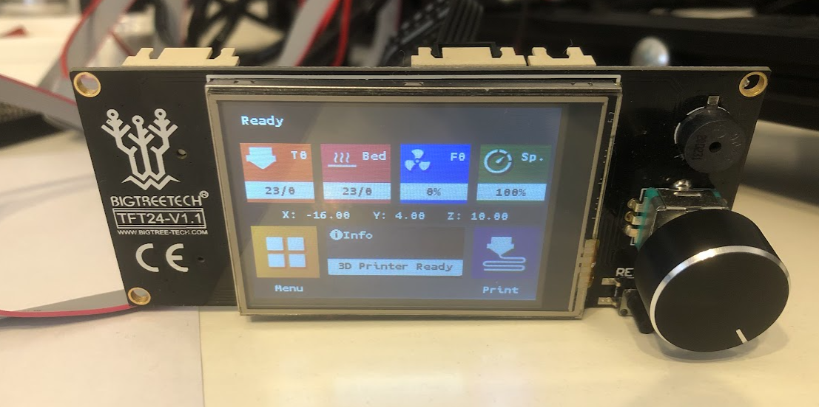
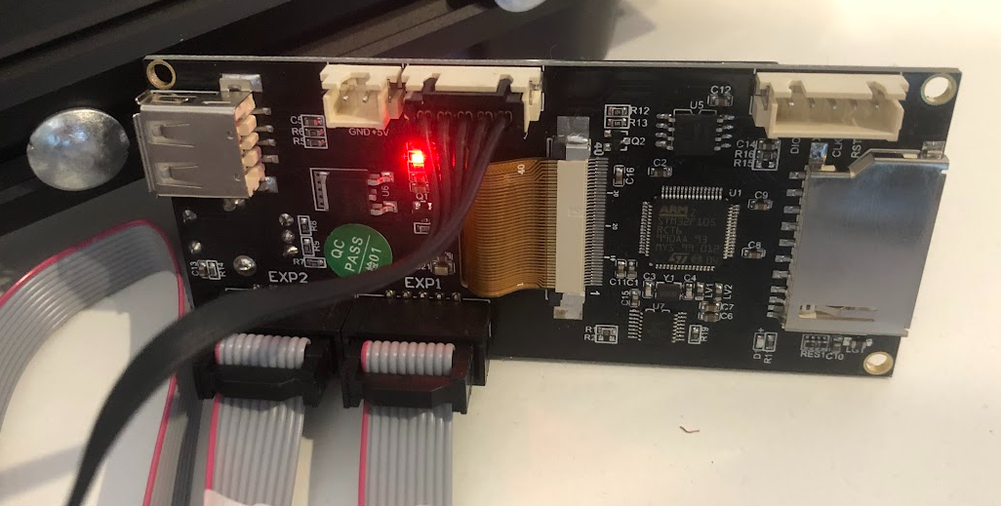
EXP1 to EXP1
EXP2 to EXP2
UART cable is to TFT port of SKR2

Slide 11
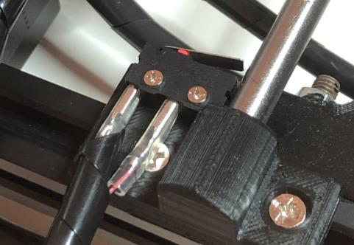
TFT port
Limit switches
Thermistors

Slide 12
GitHub - bigtreetech/SKR-2
Documentation for Visual Studio Code
Installing Marlin (PlatformIO with VSCode) | Marlin Firmware (marlinfw.org)
https://marlinfw.org/docs/gcode/M021.html

Slide 13
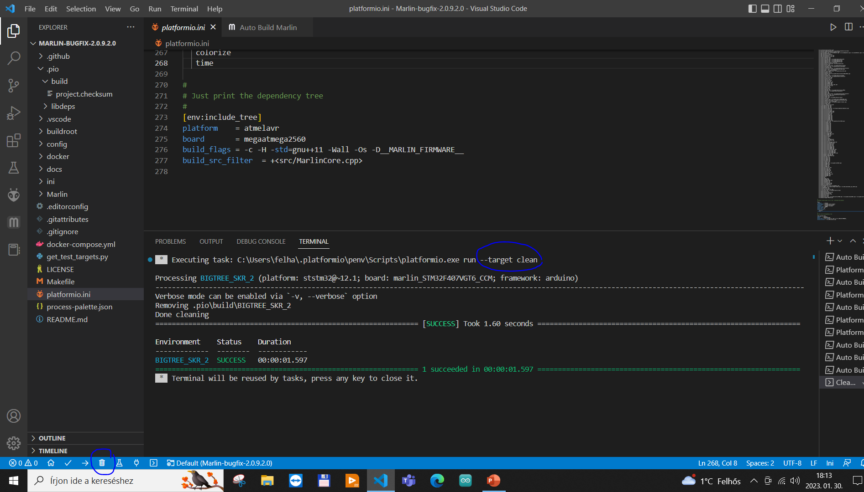
Clean ok

Slide 14
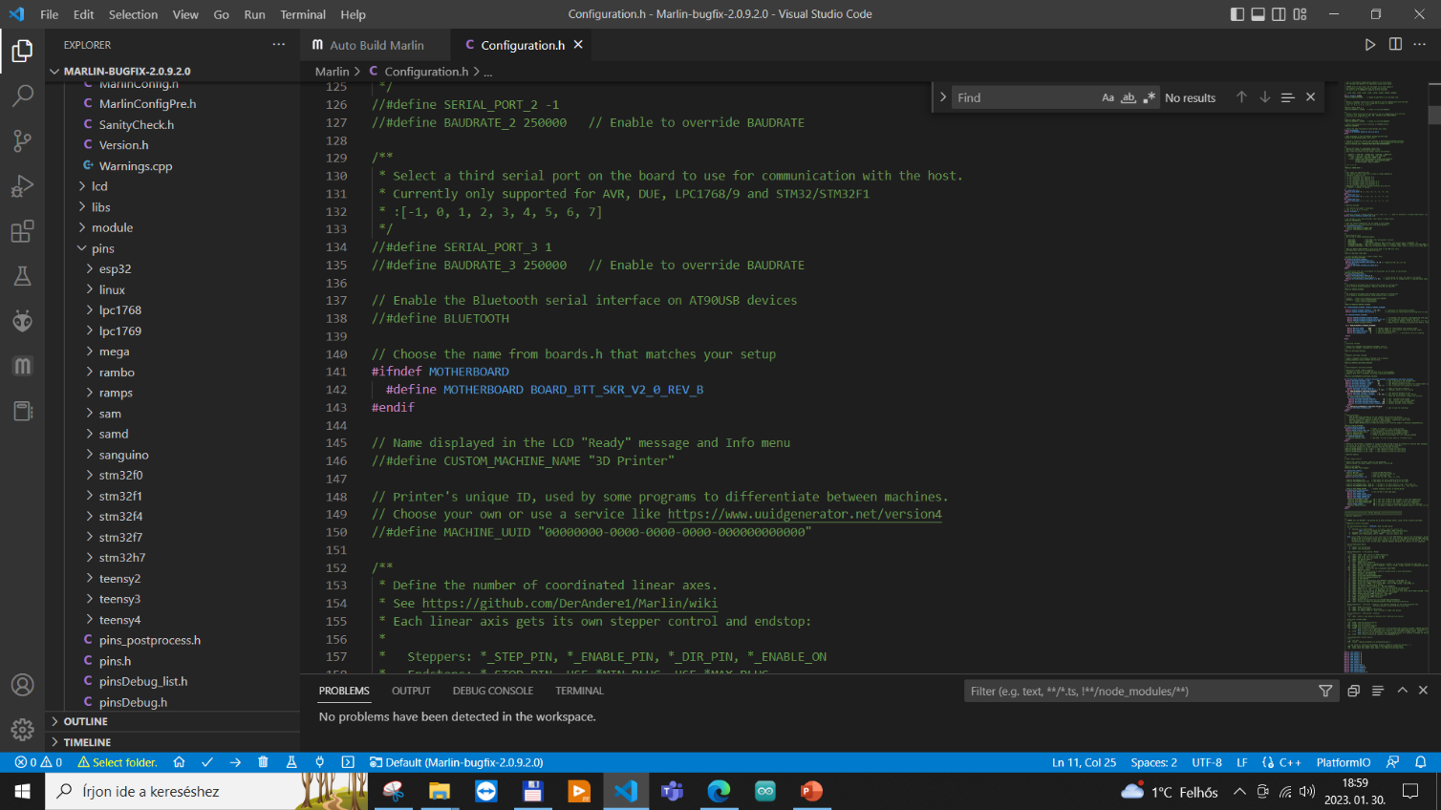
Configuration.h configured to REV B

Slide 15
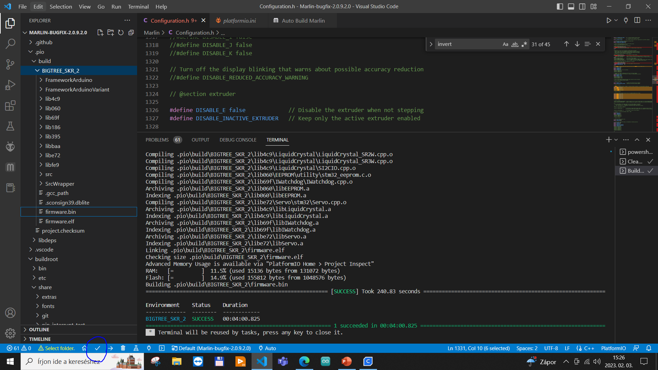

Slide 16
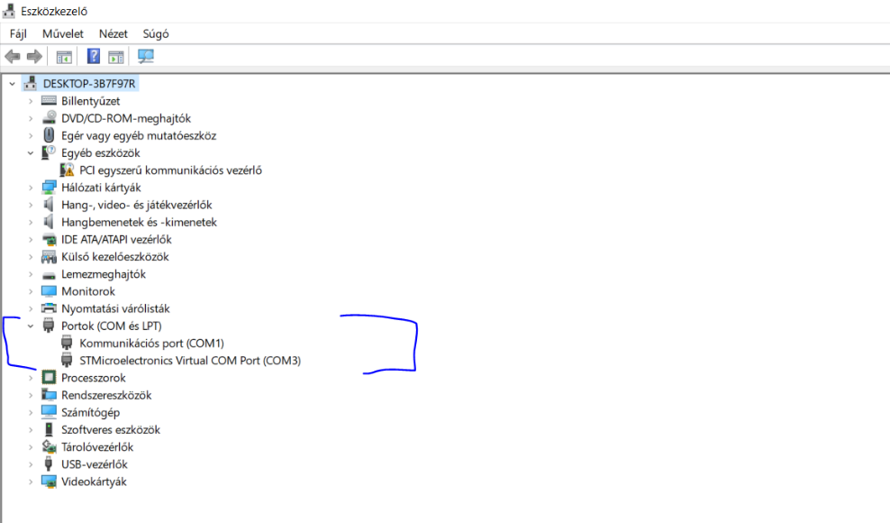
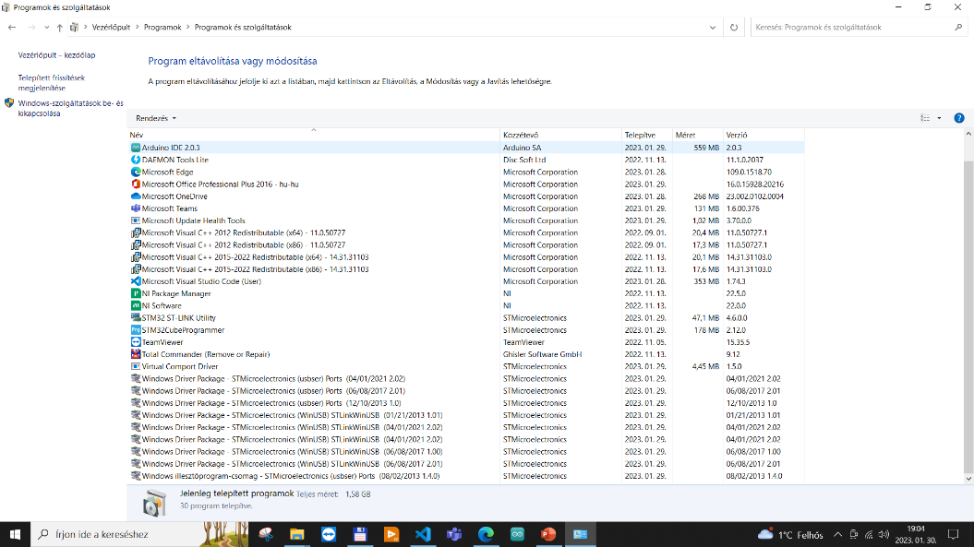

Slide 17
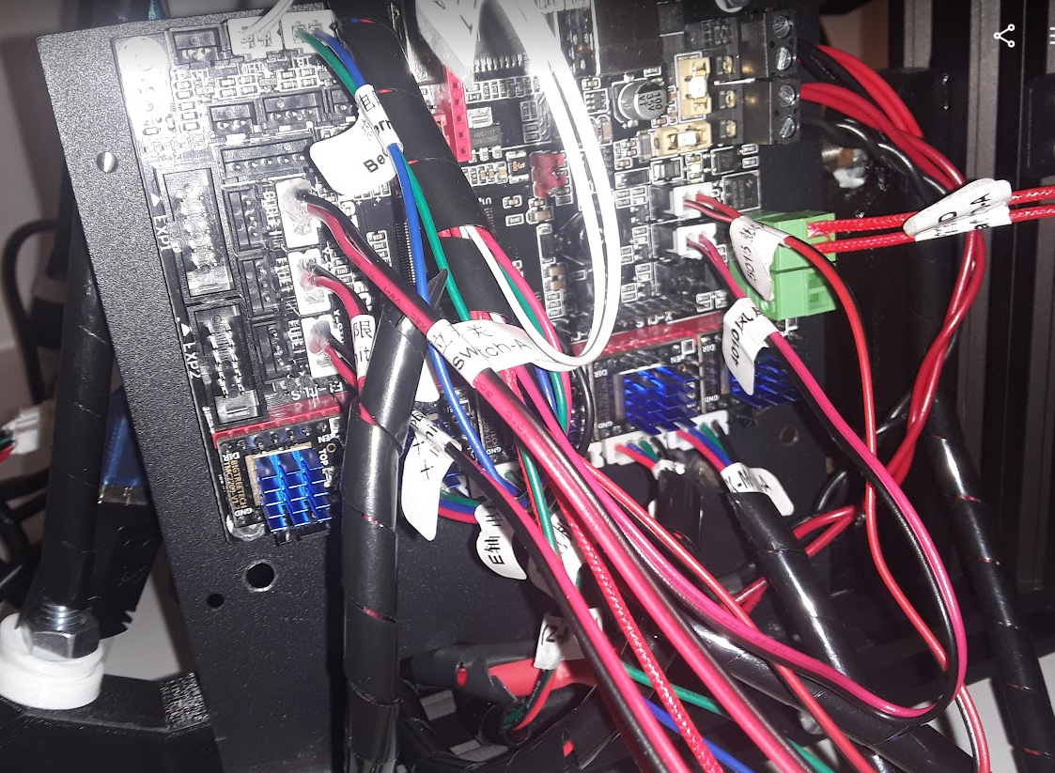
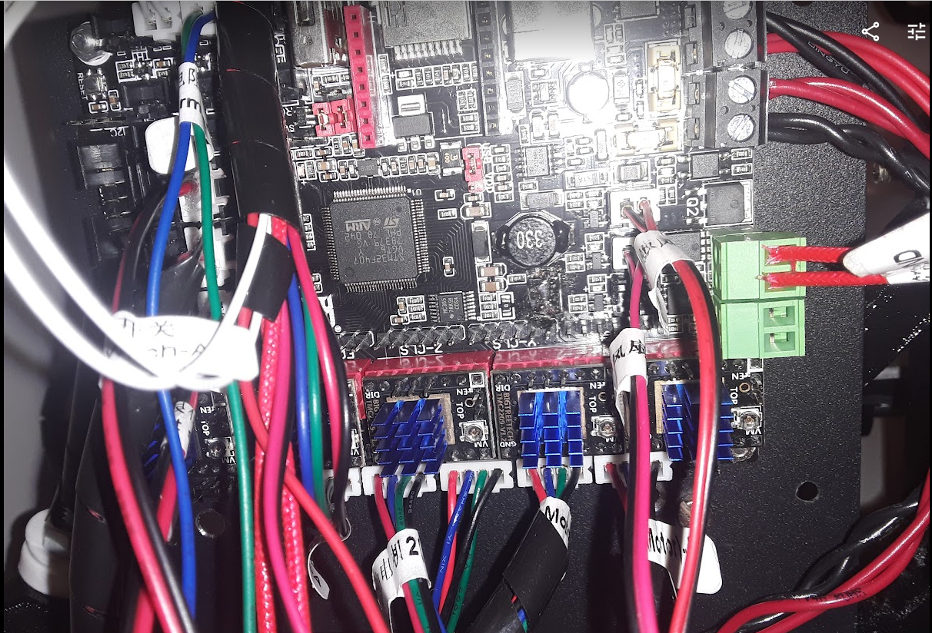

Slide 18
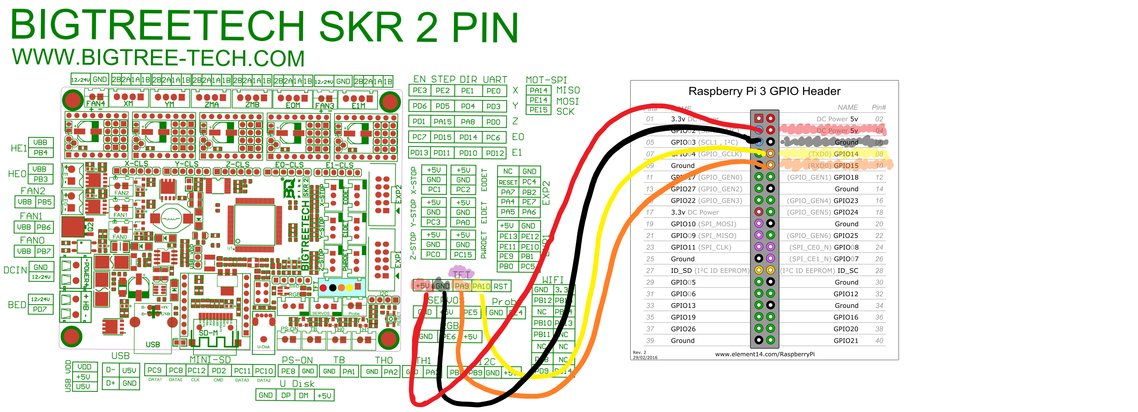
Normally update SKR via a SD card.
SD card gets the "firmware.bin" to the root folder, push SD card into the SKR, reset the board.
If this was successful you get the .bin renamed to "firmware.cur" and it is done.
Connecting RPi · Issue #13 · bigtreetech/SKR-2 (github.com)
Raspberry Pi OS – Raspberry Pi
Connecting RPi · Issue #13 · bigtreetech/SKR-2 (github.com)

Slide 19
RepRapDiscount Full Graphic Smart Controller - RepRap
Guide: SKR 2---How to install the mini 12864 screen on the SKR 2 motherboard? - YouTube
Use Anet Full Graphics LCD with Bigtreetech SKR 1.3 Mainboard and Marlin 2.0 by Hammerhead2k2 | Download free STL model | Printables.com
BTT SKR 2 Setup Guide - Sensorless Homing, BLTouch - Make 'N' Print (makenprint.uk)

Slide 20
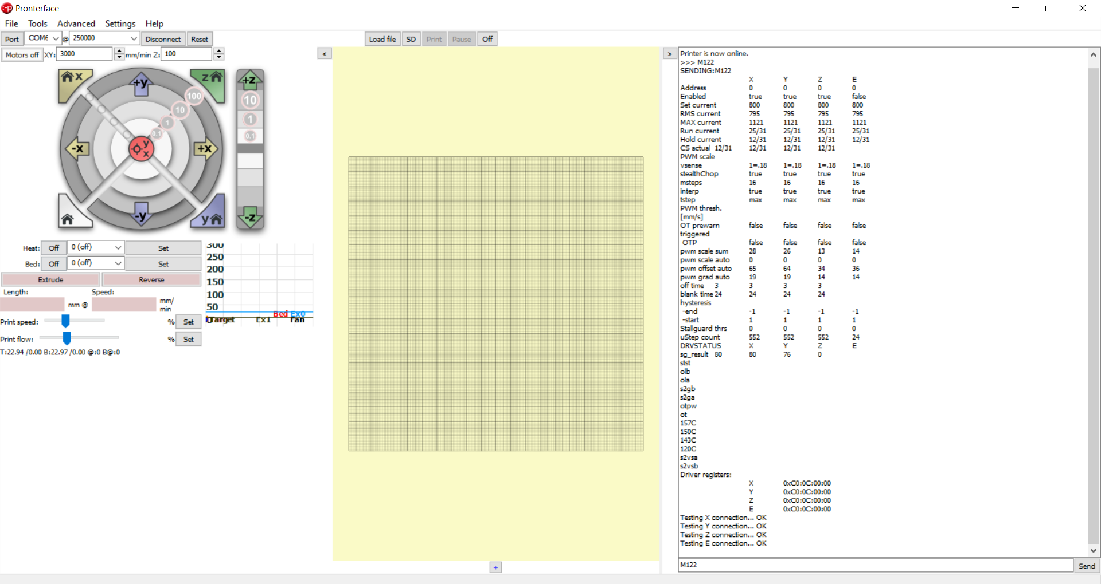

Slide 21
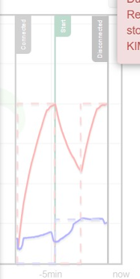
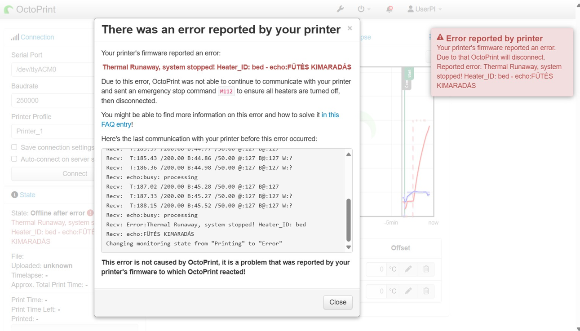
Bed Temperature – PID

Slide 22
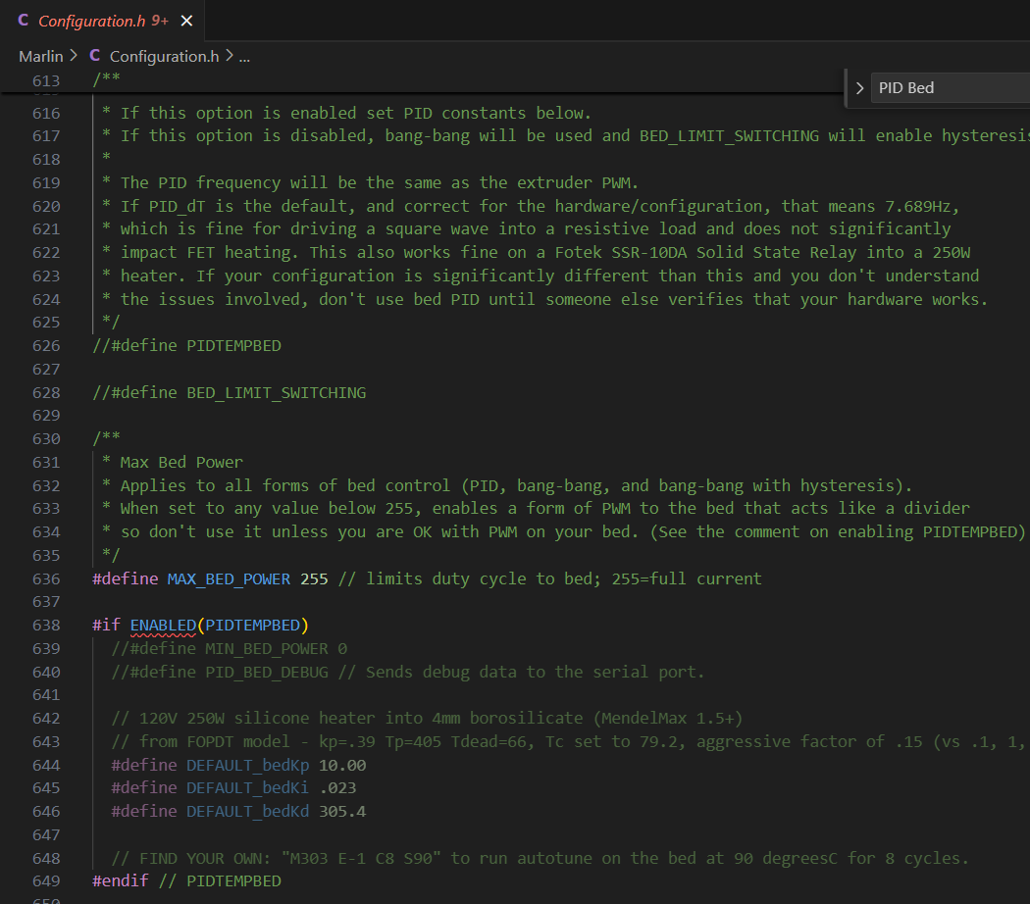
Original PID settings in Marlin

Slide 23
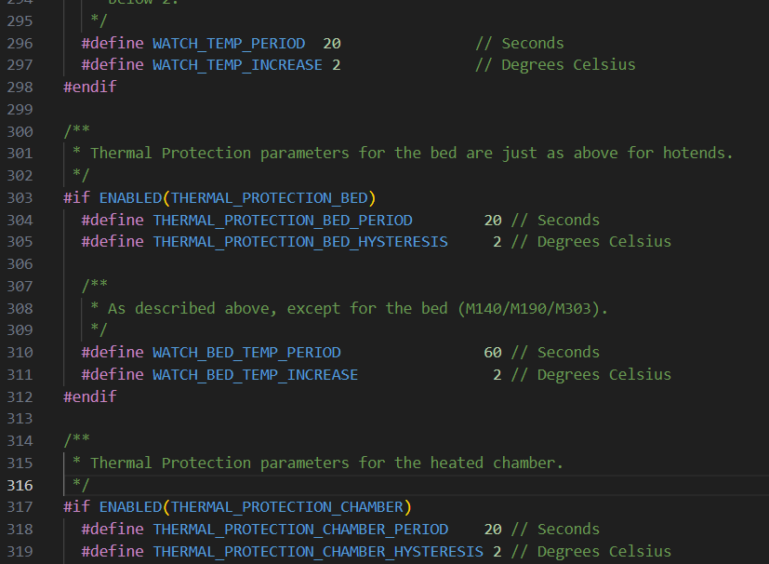
Original Bed Temp. settings in Marlin

Slide 24
